Slide 1
Doctors Without Borders
Safely Deploying MSF Workers in Response to Political Unrest
Hunter Harling, Brandon Xu, Aathreya Kadambi, Tyler Zhao

Slide 2
Stories
Contextualizing the ACLED Data

Slide 3
Identifying Stories in the Data
Two events are said to be part of the same story if all of the same actors and associated actors are the same
Identified roughly 50641 stories in the ACLED data, which we gave IDs
Examples:
ID 6: Conflicts related to JNIM (Group for Support of Islam and Muslims) and VDP (Volunteer for Defense of Homeland)
ID 9652: Events relating to the Military Forces of Russia (2000-) and other groups
ID 9660: Events relating to Russia-Ukraine Conflict
ID 5216: Events relating to Israel-Palestine Conflict
Allows for more detailed and contextualized conflict mapping
Stories roughly correspond one-to-one with “conflicts” (Assumption)
Notes:
Hone in on Data isn’t necessarily meaningful without an understanding of the underlying story
Having these stories allows for more detailed and contextualized conflict mapping

Slide 4
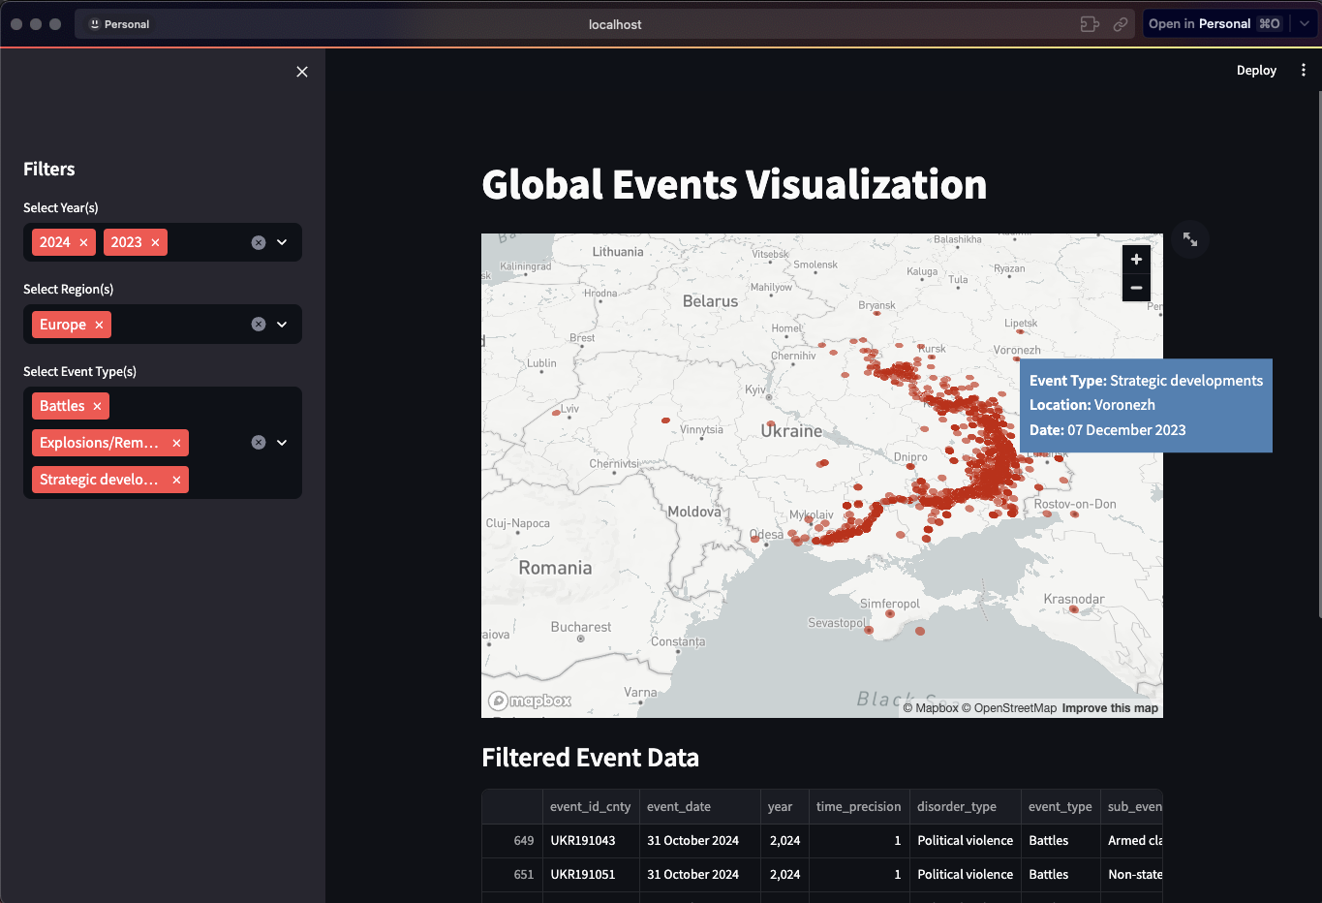
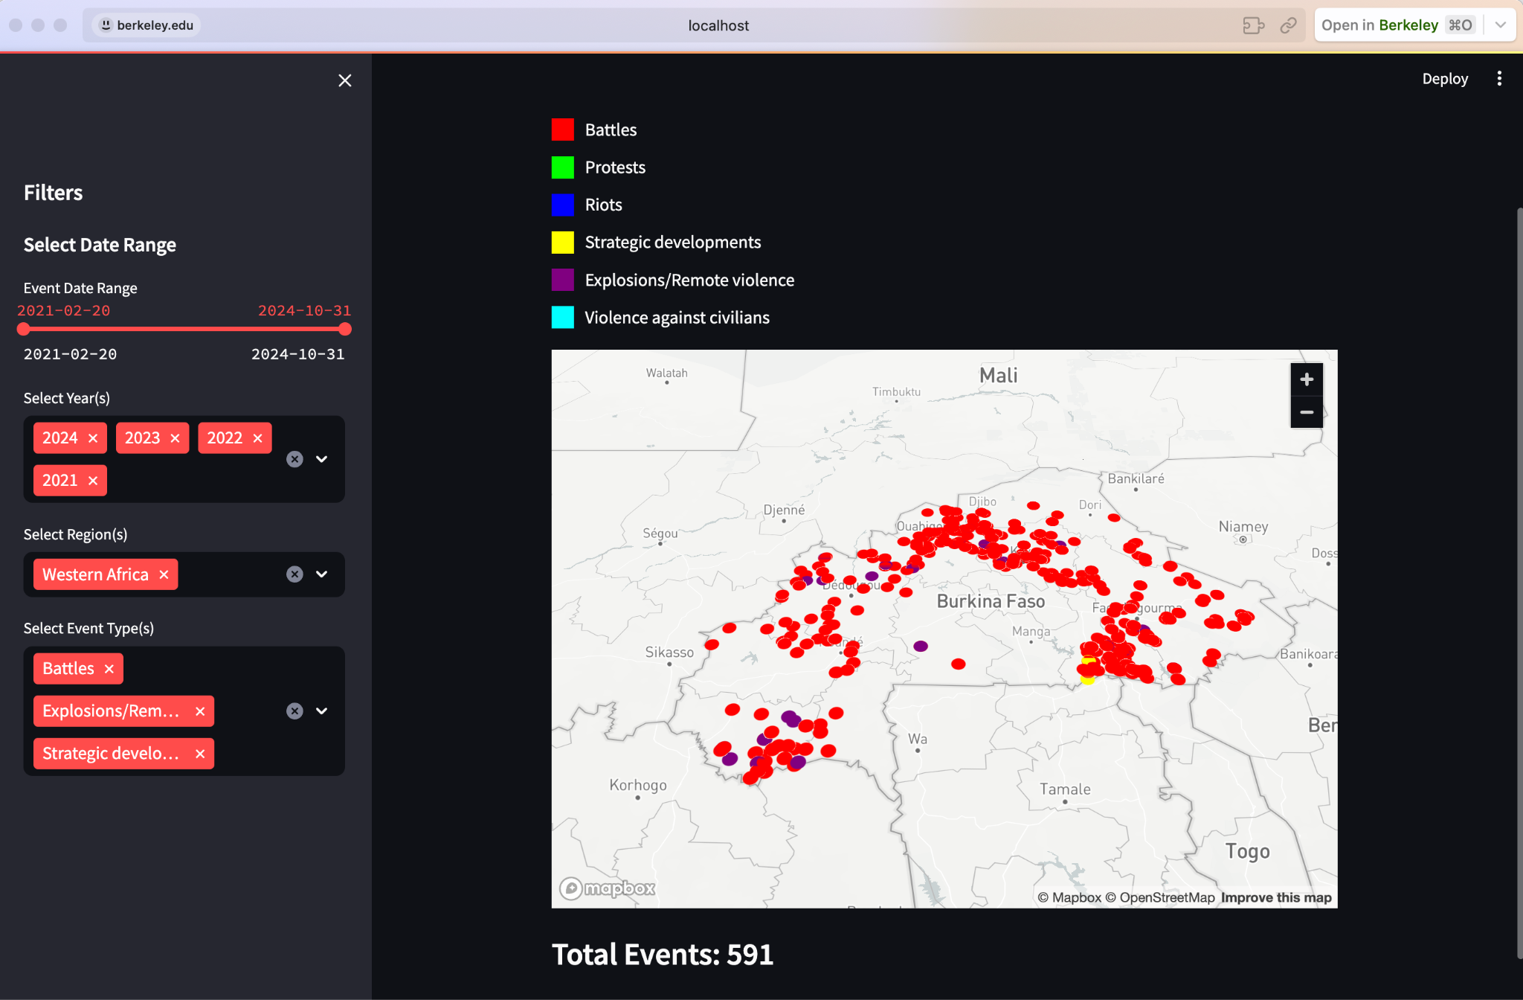
Conflict related to JNIM (Group for Support of Islam and Muslims) and VDP (Volunteer for Defense of Homeland) (Visualization Built with Streamlit)

Slide 5
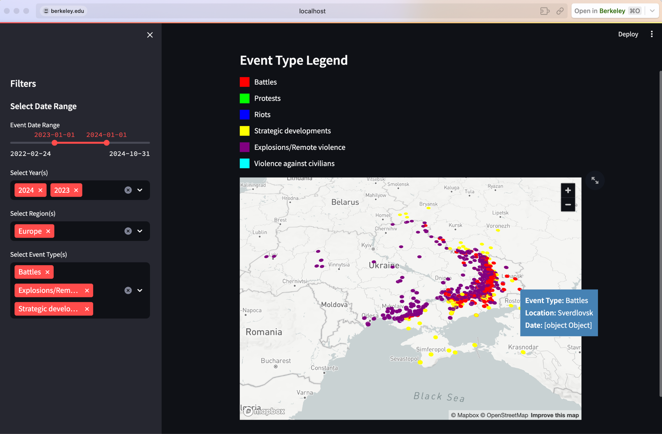
Russia-Ukraine Conflict Events (Visualization Built with Streamlit)

Slide 6
Modeling Considerations
Benefit of stories: allow us to assume different stories are roughly independent
We will discuss this further with model limitations
Deployment of aide and resources can be considered on a per-story basis, which gives MSF workers much more context
Each story can correspond to an individual “time series” or “sentence”
Can be modeled autoregressively, motivating different approaches:
Transformers
LSTMs
Decision trees and random forests
Notes:
Multiple dependent events making up one story
A big benefit is that they are roughly independent with multiple dependent events making up one story

Slide 7
Risk Assessment
Safely Deploying Humanitarian Aid

Slide 8
Model Architecture
Don’t take into account news data yet, so are better at predicting on events that are already occurring
Considerations:
“Token” Encodings
Positional Encodings
Loss Function and Regularization Terms
Risk Classification
Two Model Ideas:
Day-level granularity
Issue of dealing with aggregation, but more applicable
Timestamp-level granularity
Notes:
Overview of our model architecture
One thing to note is that our model doesnt take in account news data, but this will be addressed later
Additionally, our

Slide 9
“Token” Encodings
Relevant Features:
Conflict Type
Civilian Targeting **
Admin 1 *
Latitude *
Longitude *
Geo Precision *
Fatalities
* Removed in day-level model to allow for
easier data aggregation into modeling over
days.
** Read in from ‘interaction’ feature instead.
Encoding Strategy
1/7 for Demonstrations, 2/7 for Strategic Developments, 4/7 for Political Violence
No change necessary
Numeric encoding based on list of all possible admins *
No change necessary *
No change necessary *
No change necessary *
No change necessary
<sos>: [1, 0, 0]
Notes:
day level granularity which led to aggregation issues, but it’s more applicable for determining if someone should be
Deployed on a given day
Features with asterisks cannot be aggregated so were left out for now, but could be used in the future / with more granularity

Slide 10
Positional Encodings
Dim: [B, 12]
Day 1 Emb
Fully Connected Layer
Day 2 Emb
Day 3 Emb
Aggregation
Token Encoding
Positional Encoding
Day 1
Day 1
Day 1
Day 1 Agg
Day 1 Emb
Day 1 Emb + Pos
Day 2
Day 2 Agg
Day 2 Emb
Day 2 Emb + Pos
Day 2
Day 3 Agg
Day 3 Emb
Day 3 Emb + Pos
Day 3
Dim: [B, 3]
Dim: [B, 3]
Day 3
Dim: [B, 12]
Day 3
Day 3
Linear layer on each Day’s encodings to make number of dimensions even (to make compatible with sinusoidal initialization)
Sinusoidal Initialization (Following Attention is All You Need)
Learned Positional Encodings (Positional Encodings are Parameters)
B = Batch
Size
Notes:
At first, our loss was very large, in part because we were attempting to learn the positional encodings as parameters. Initializing them with the sinusoidal
Embedding from the attention is all you need paper significantly reduced our loss in the first epochs and allowed our model to converge earlier

Slide 11
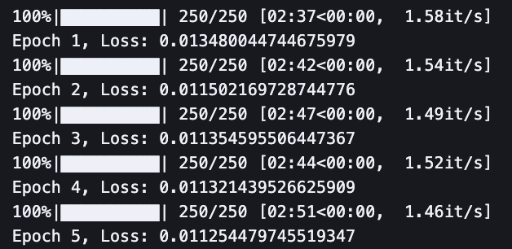
Loss and Regularization
Transformer
Block (Encoder + Decoder)
Linear
Day 1 Emb + Pos
Output 1
Pred 1
Day 2 Emb + Pos
Output 2
Pred 2
Day 3 Emb + Pos
Output 3
Pred 3
Dim: [B, 12]
Dim: [B, 12]
Dim: [B, 3]
Used MSE loss since input and output are 3-tensors
Given quantity of data, 5 epochs (loss increases subsequently)
We believe regularization would be useful to enforce other constraints:
Violence in one area increases risk of violence in nearby areas
Worse to predict no violence and find there to be violence
Final loss: 0.0113, slightly deceiving, but shows some learning
Better with much more data (only trained on top 1000 stories)

Slide 12
Risk Classification
State 0: 0 fatalities, only demonstrations for disorder type, and no civilians targeted
State 1: Political violence events and no fatalities, or demonstrations, or civilians targeted and at most 2 fatalities
State 2: Political violence events and between 1 and 5 fatalities with civilians targeted, or no civilians targeted and at least 3 fatalities
State 3: Over 5 fatalities
Manually chosen states to allow for more human oversight, discussion, and interpretability.
Ideally, we would like to deploy in regions that have recently transitioned to State 0, so that MSF workers have the highest impact while being in the safest environments.
Notes:
Using this model we can identify regions in that have transitioned to state 0, which enables MSF workes to have high impact while being in a safe environment

Slide 13
Alternative Approach: Autoencoder
Creative approach we didn’t flush out (yet)
We actually care mostly about not accidentally mistaking war for peace
Would rather identify State 0 as State 1 or 2 rather than identify State 3 as State 0
Train autoencoders to identify the state, minimizing reconstruction loss, regularizing to minimize above error

Slide 14
Enhancement with Real-Time News
Prediction of New Conflicts and Stories

Slide 15
Limitations of only using incident data
News sources offer insight into what incident data does not show
An incident-free place may actually be high risk
The Russian invasion of Ukraine had no violent incidents per se in the lead up to the 2022 invasion
Tracking news leading up to the invasion makes it obvious that the region was at high risk of war breaking out

Slide 16
Determining Risk via Sentiment Analysis
GDELT + New York Times news data from
Used Google Translate API to translate texts from local languages of GDELT articles
KeyBERT
Sentiment analysis
Google Translate API
Input Country
NYT Headlines
Translatis
GDELT
Past 2 weeks news headlines
Time weighted risk score based on embeddings
Predictions
KeyBERT Embeddings
KNN
Embedded Sources
New Sources
Risk
Headline 1
Headline 1
0.9
Headline 2
Headline 2
0.5
Headline 3
Headline 3
0.1

Slide 17
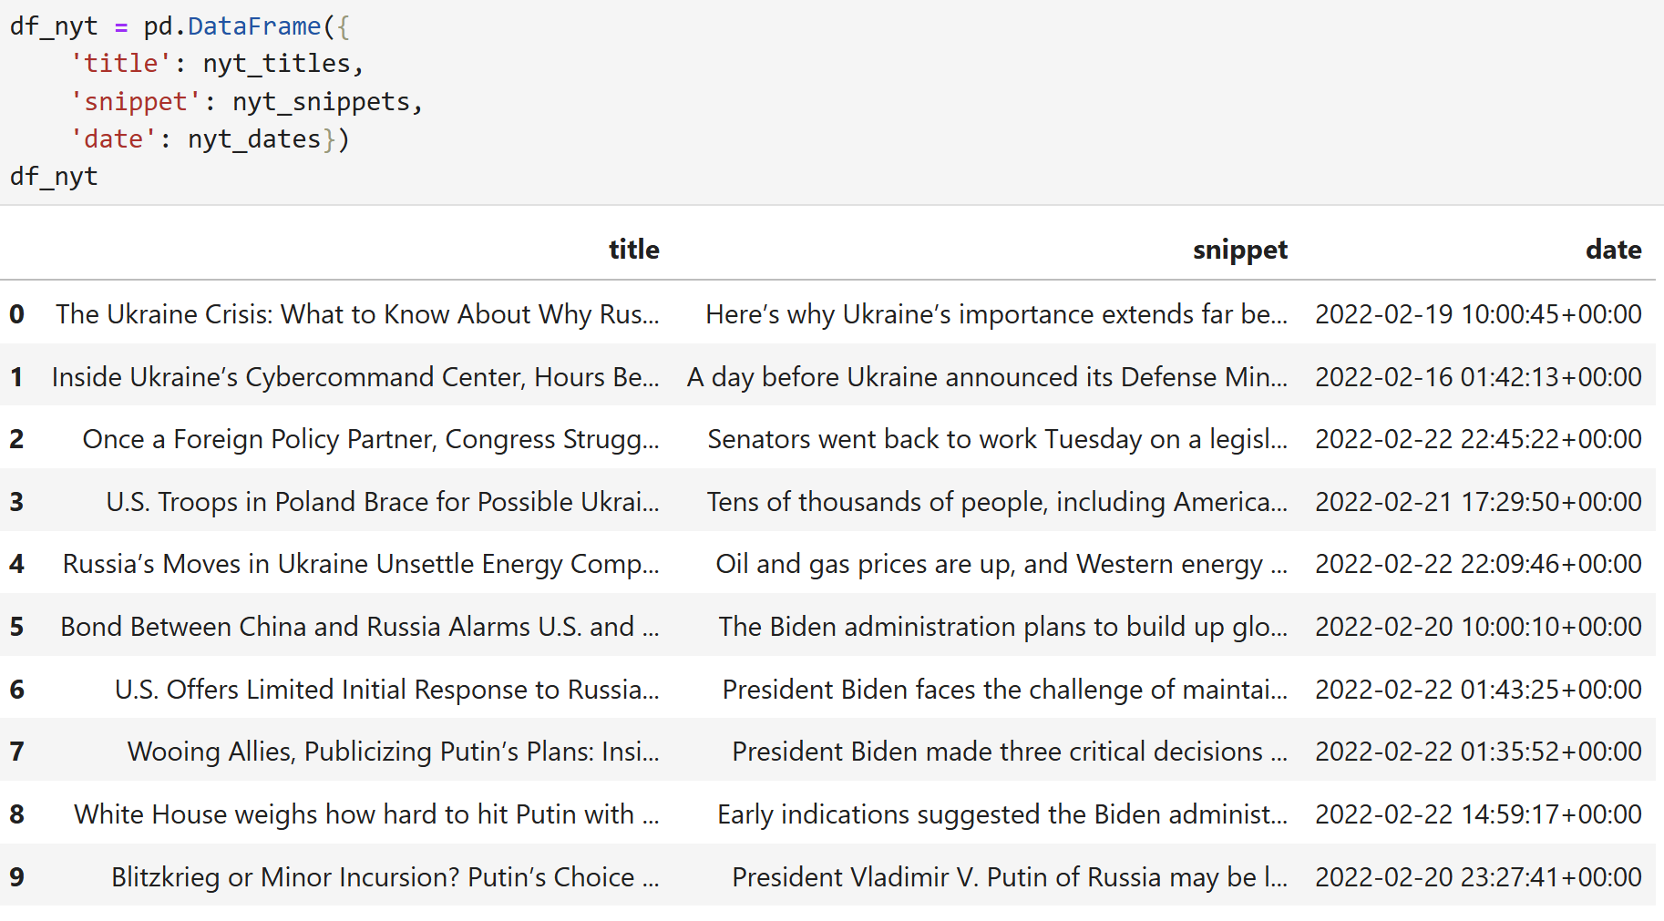
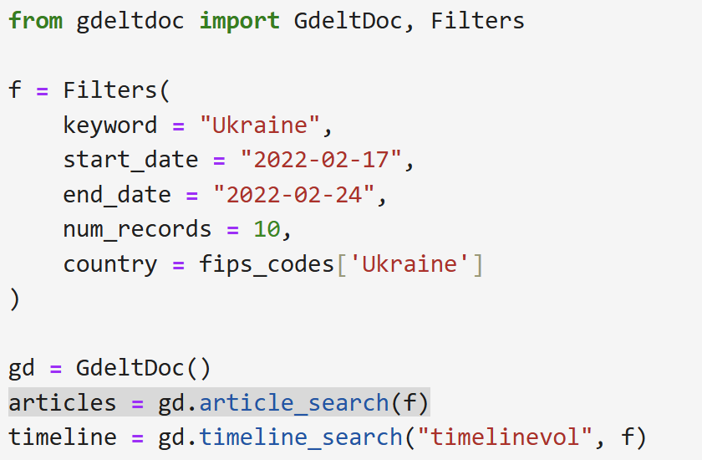
Sourcing New York Times articles about Ukraine in from Feb 17 2022 to Feb 24 2022
Sourcing local news articles from GDELT in the same timeframe

Slide 18
Limitations of news-based approach
Some news titles are misleading to a language model
E.g “South African police lay siege to illegal mines operating with trafficked labour” would sound highly risky to a model due to “lay siege”
Ought to be paired with our human contextual understanding
Headlines sometimes lack critical nuance (news agencies might want to make it attention-grabbing, etc)
News headlines from Reddit’s r/news was considered initially
Not used in the end due to availability of headlines from NYT and GDELT with better average journalistic quality

Slide 19
Further work for news analysis
Better language model as opposed to keyBERT all-MiniLM-L6-v2
A better model that has been pre-trained for news headlines
Further fine-tuned for geopolitical news headlines
Large dataset of headline-to-risk score mappings can be compiled
Current dataset only has 500 rows

Slide 20
Summary
A final risk score assessment is made by combining incident-analysis and news-analysis outputs
Future risks are predicted based on past events and recent news information
Models are never perfect
Ought to be paired with nuanced human understanding of situation

